Slide 1
.
Universal Design of Learning (UDL):
Accessible Digital Resources and Assistive Technologies
.
Prof. Renu Malaviya
Dept. of Education
Lady Irwin College
University of Delhi

Slide 2
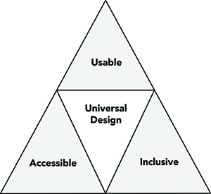
Universal Design of Learning (UDL)
प्रयोग करने योग्य
सीखने का सार्वभौमिक डिज़ाइन
समावेशी
अभिगम्य
An approach to ensure that educational programs serve all students. UDE goes beyond accessible design for people with disabilities to make all aspects (पहलू) of the educational experience (शैक्षिक अनुभव) more inclusive (समावेशी) for students, staff, instructors, administrators, and visitors with a great variety of characteristics, including those related to gender, race and ethnicity, age, stature, disability, and learning preference.

Slide 3
.

Slide 4
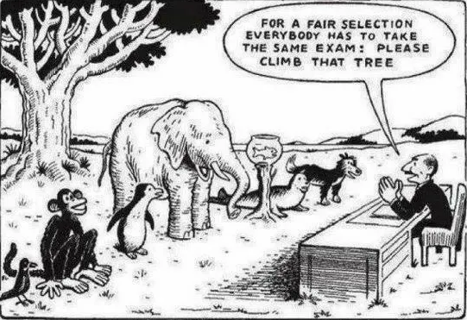
Why UDL???? As Everyone is different
निष्पक्ष चयन के लिए सभी को एक ही परीक्षा देनी होगी
हमारी शिक्षा प्रणाली

Slide 5
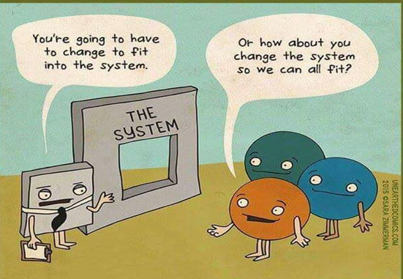
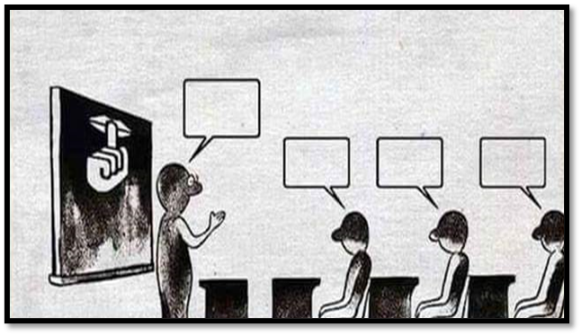

Slide 6
.
SO MANY DROP-OUTS!!!!

Slide 7
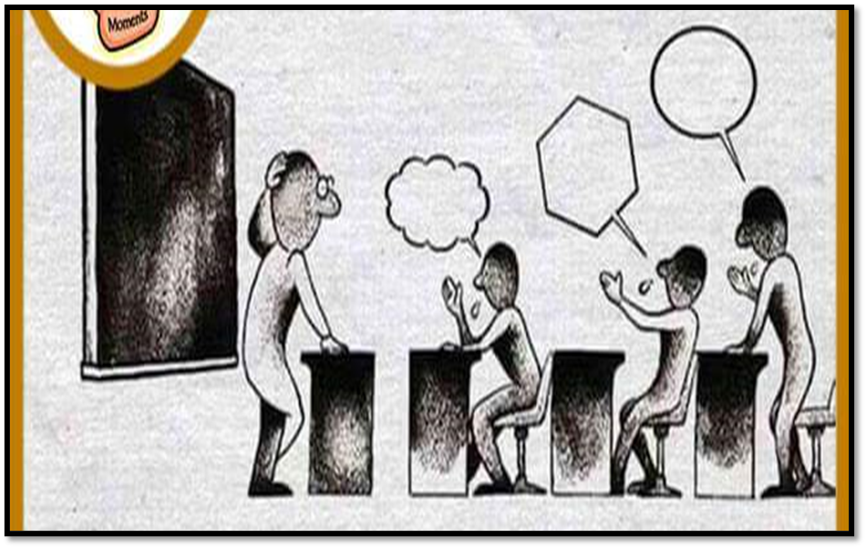
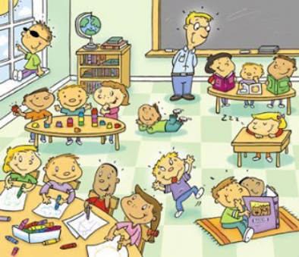
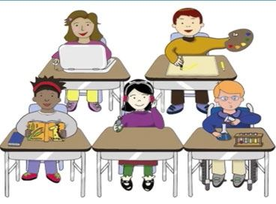

Slide 8
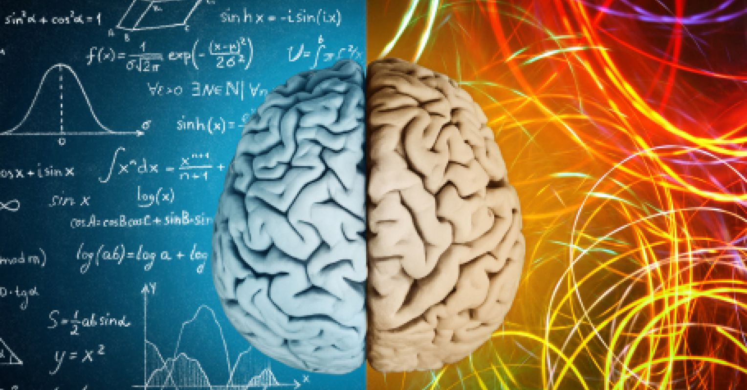
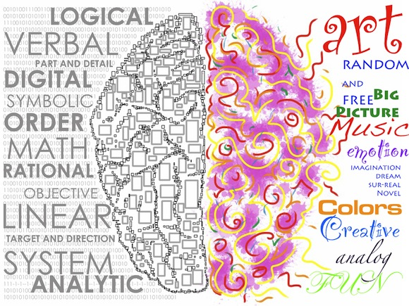
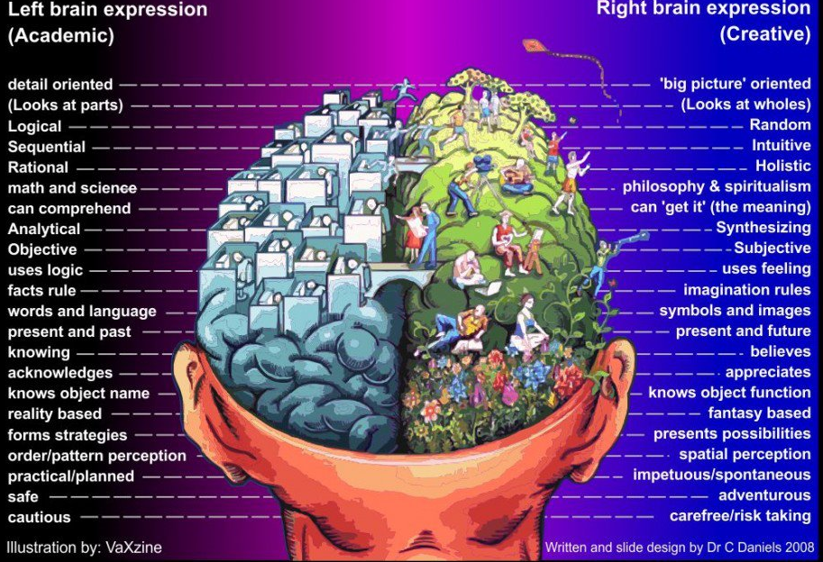
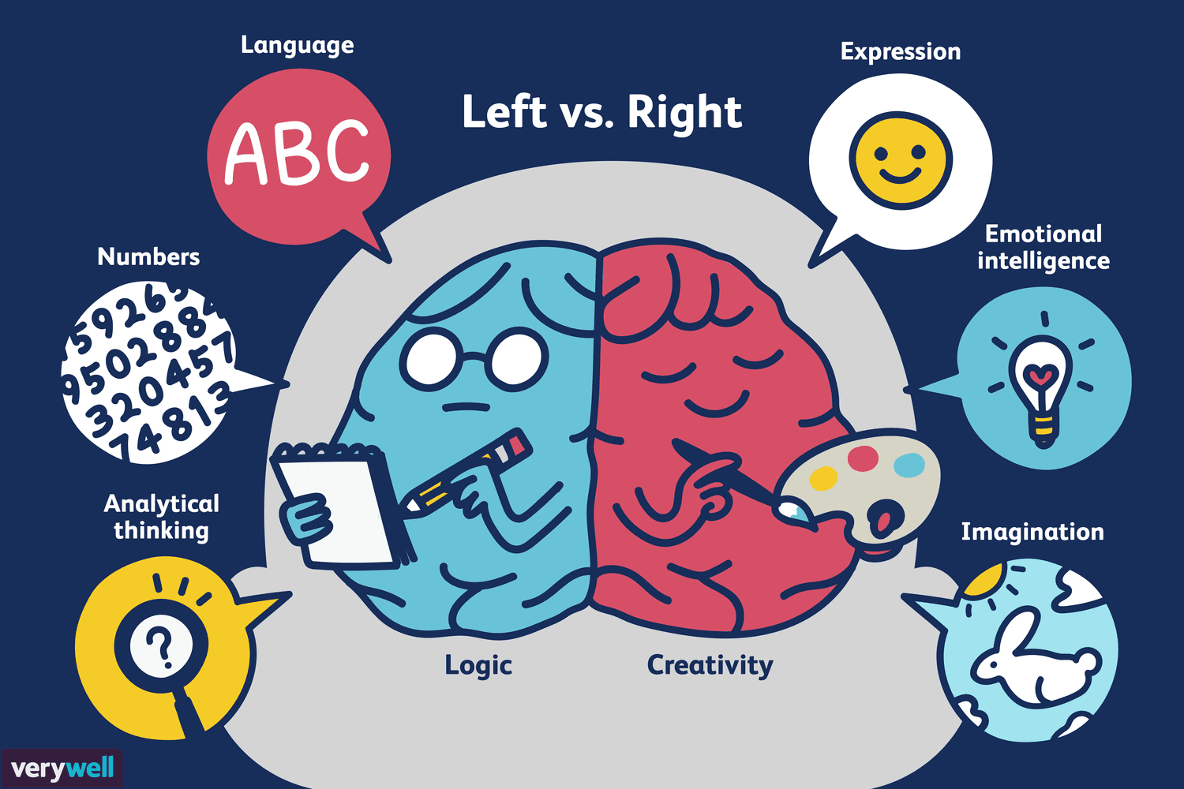
.
Different Types of brains

Slide 9
.
Multiple Intelligence

Slide 10
.

Slide 11
.

Slide 12
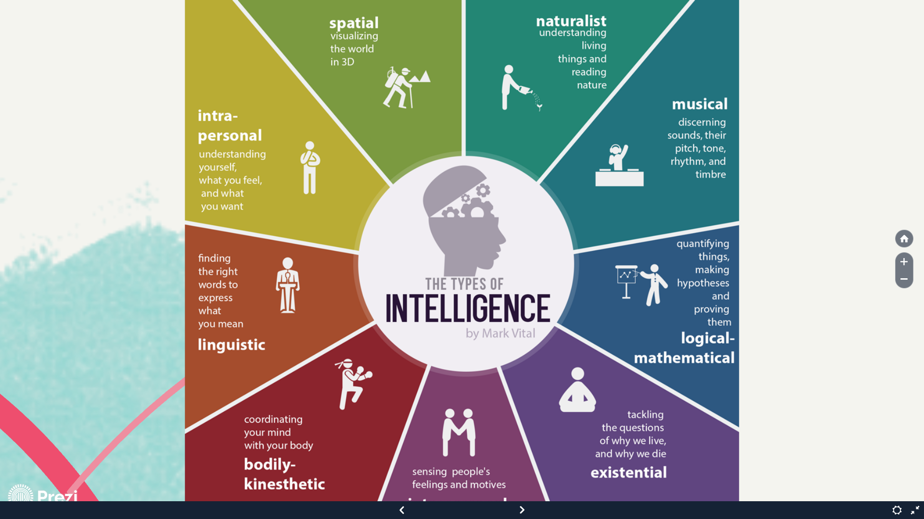
.

Slide 13
.

Slide 14
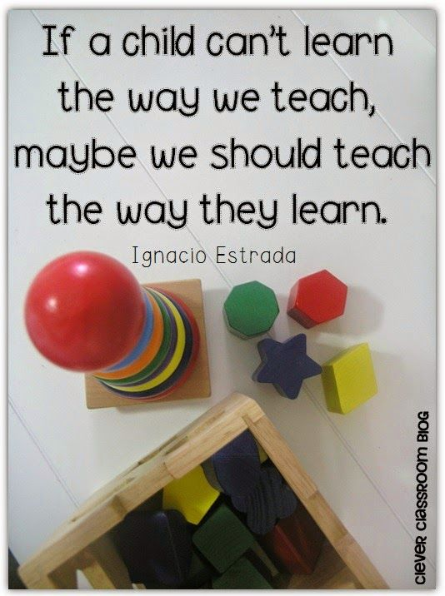
.

Slide 16
.
विद्वता
निर्देश
कार्यकलाप

Slide 17
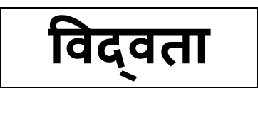
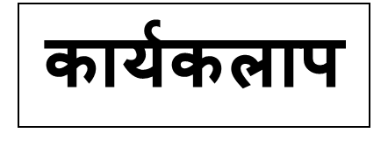

Slide 19
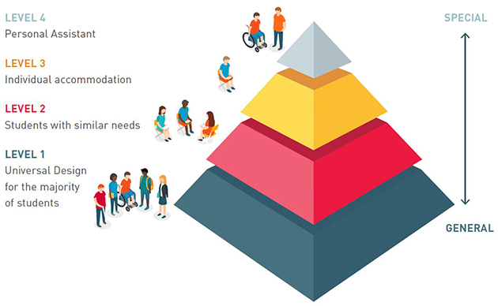

Slide 20
.

Slide 22
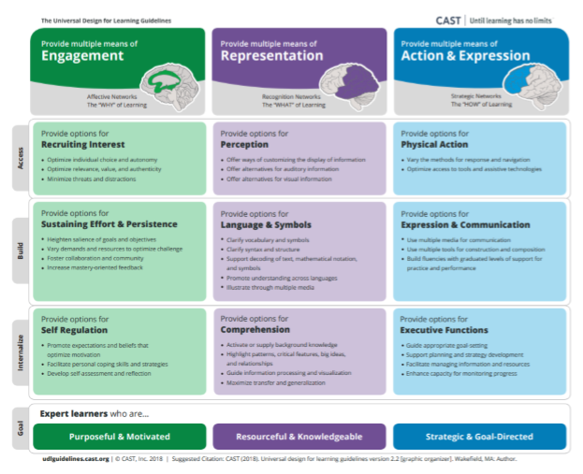

Slide 23
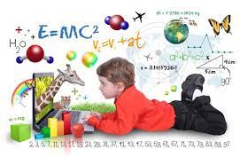
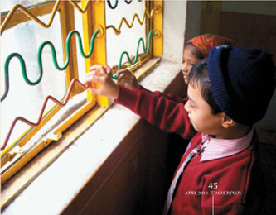
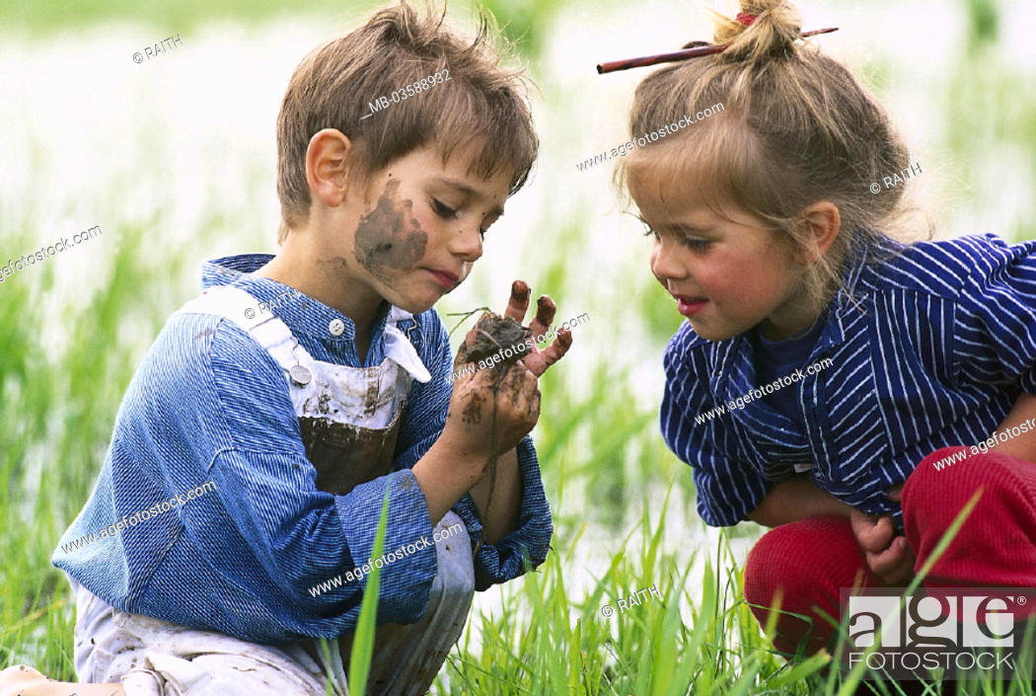
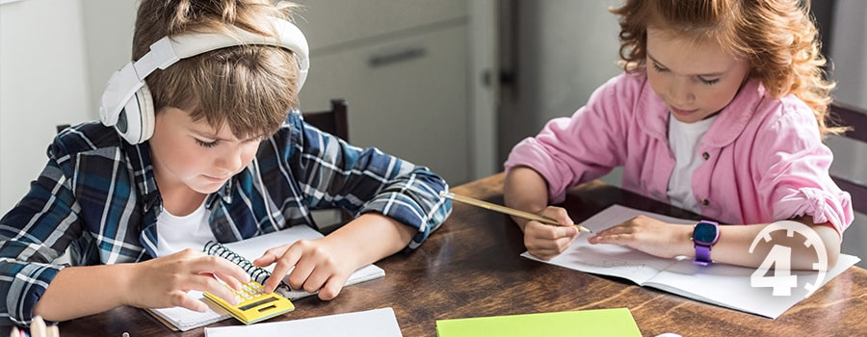
Different ways of Engagement: The Why of Learning

Slide 24
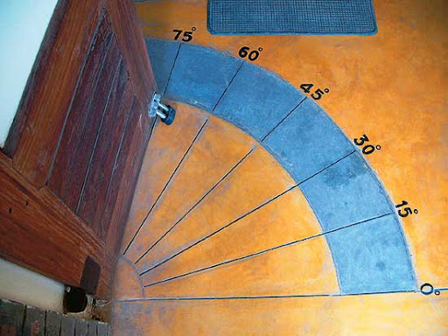
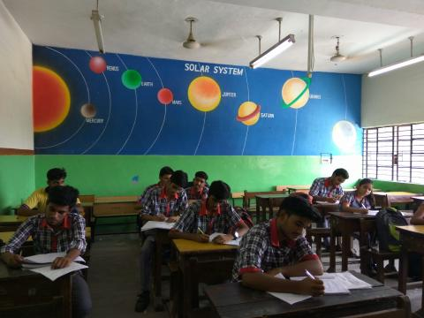
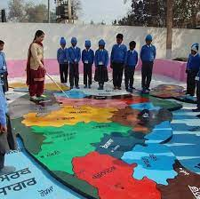
Different types of Representation: What of Learning

Slide 25
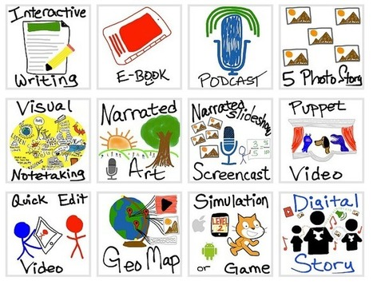
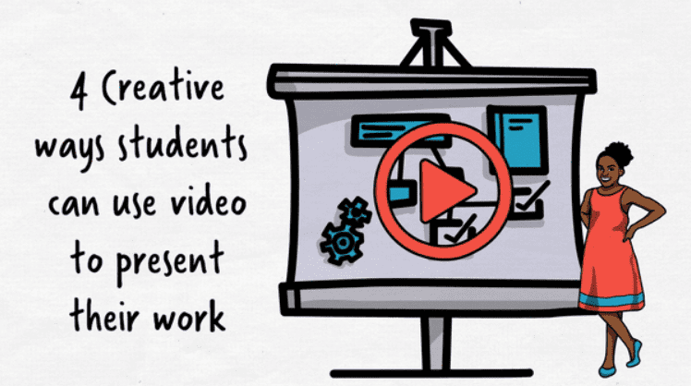
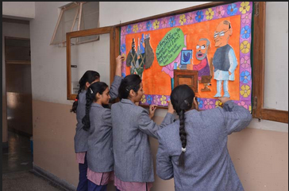
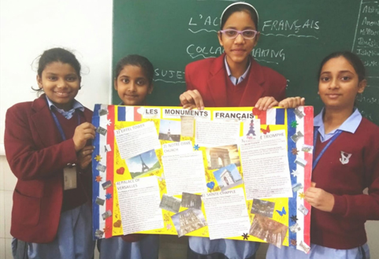
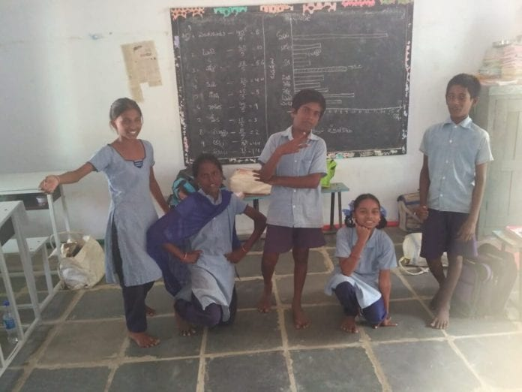
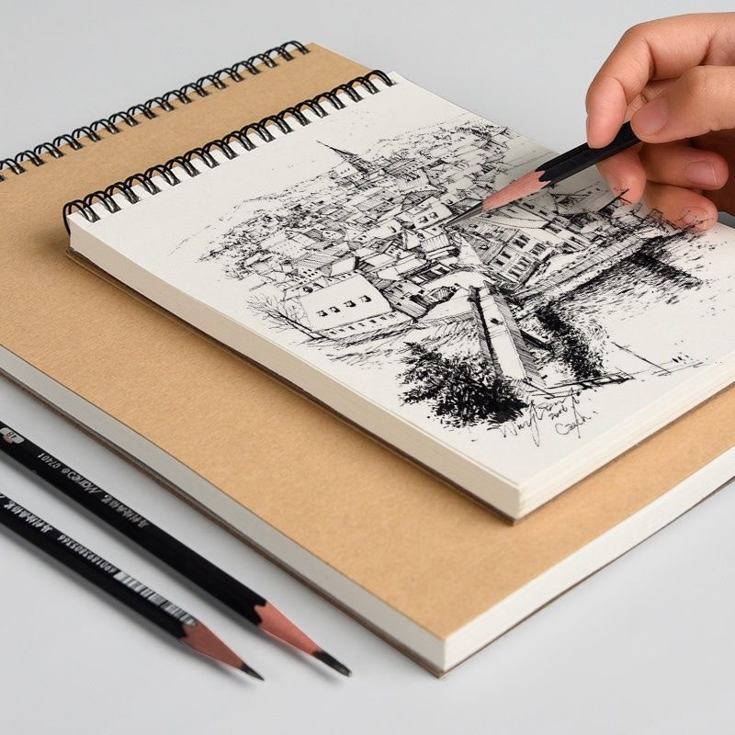
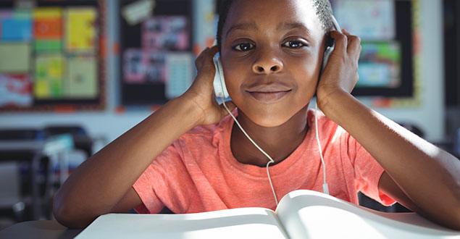
Different types of Action & Expression

Slide 26
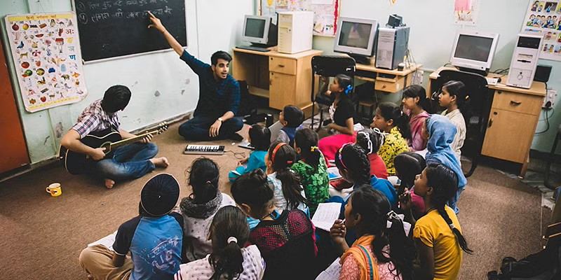
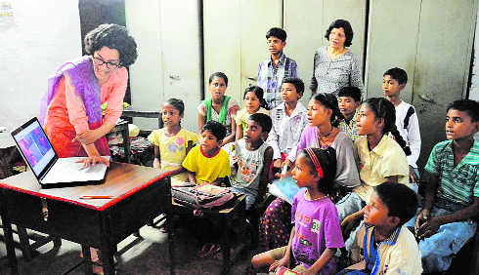
Action and Expressions

Slide 27
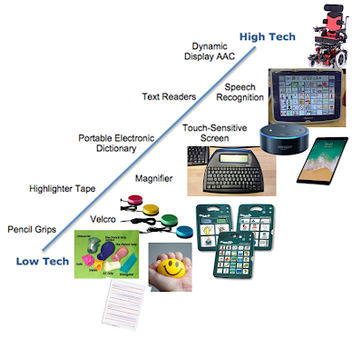
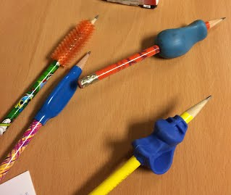
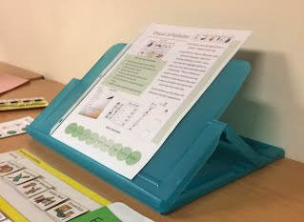

Slide 28
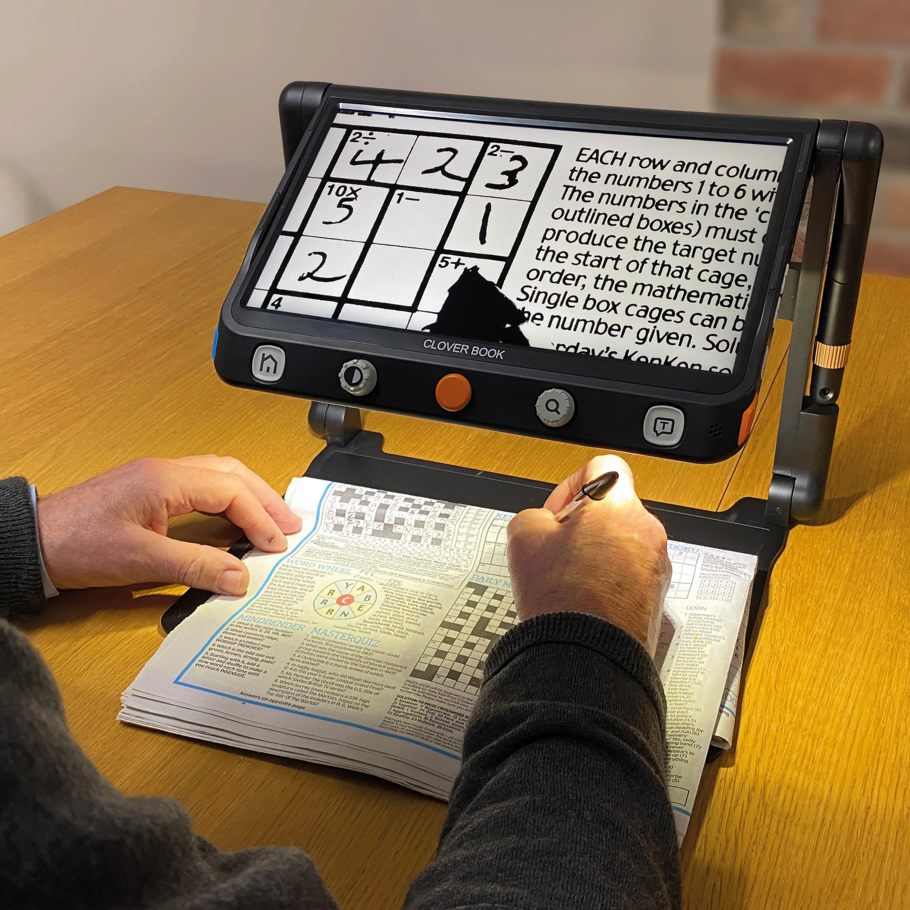
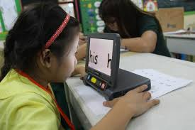
Assistive Devices and UDL
Screen magnifiers

Slide 29
Assistive Devices for Hearing Challenged
Teletypewriter (TTY)
Telecommunications device for the deaf (TDD)
Voice to text software programs
CART Communication Real-Time Translation
Personal FM systems
Soundfield systems
Captioning Services for video/audio productions
Face to Face Communication Systems

Slide 30
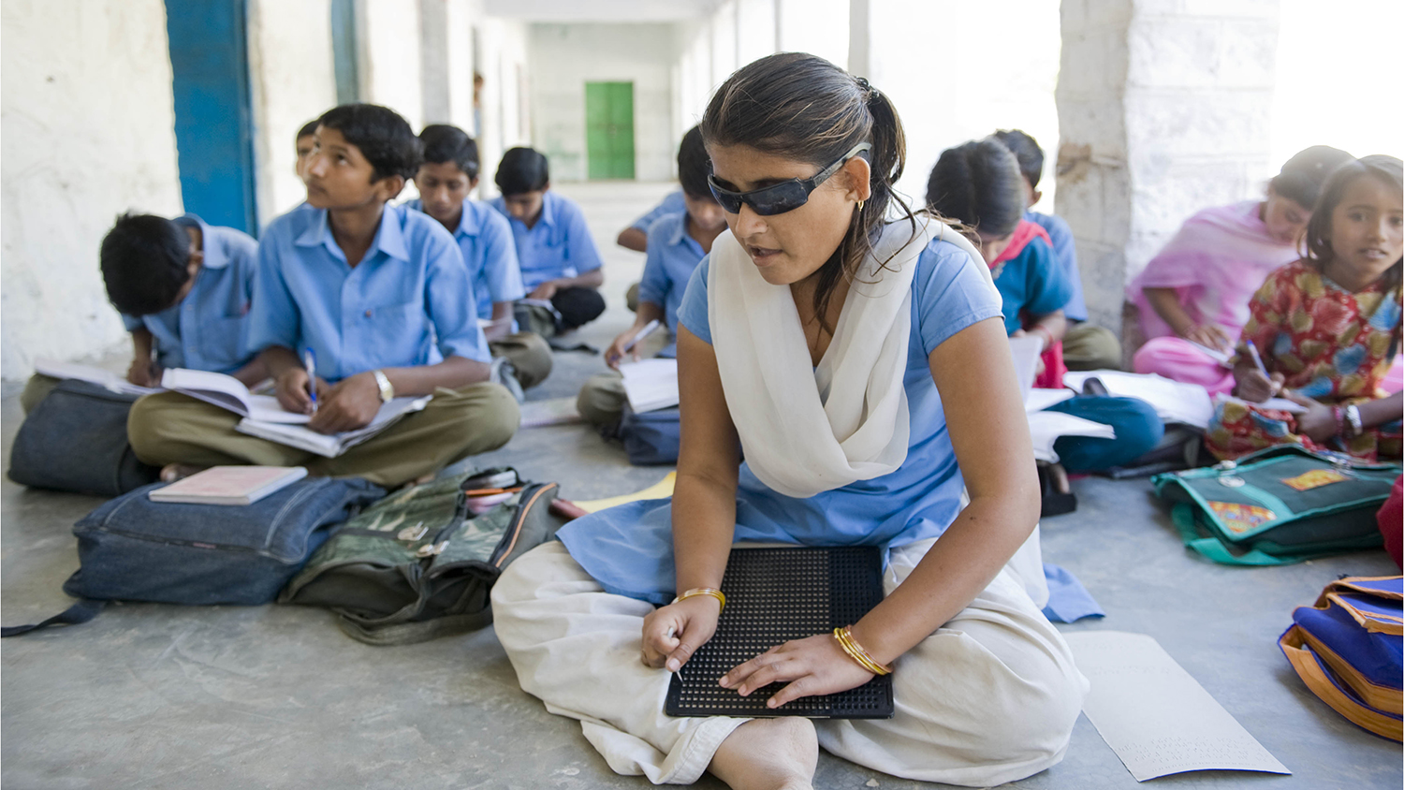
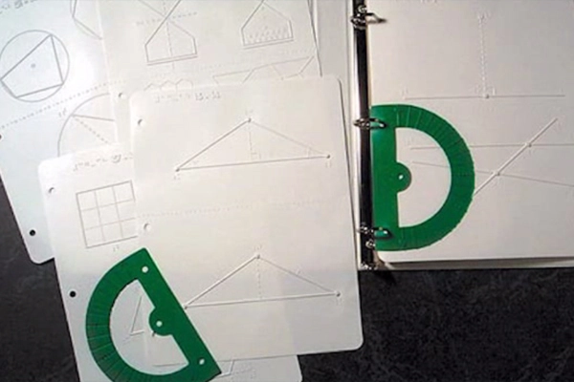
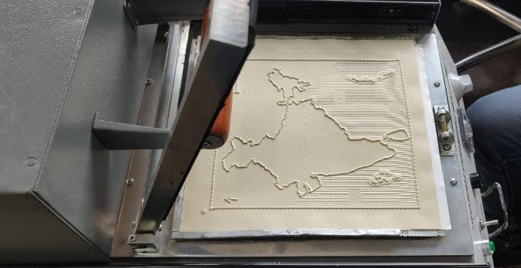
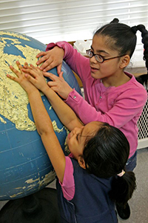
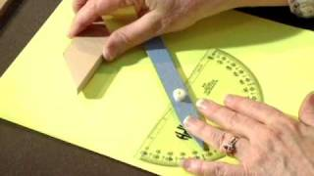
Assistive Devices for Visually Challenged

Slide 31
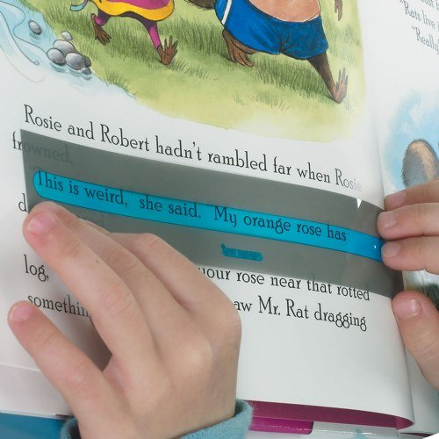
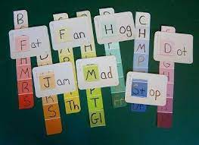
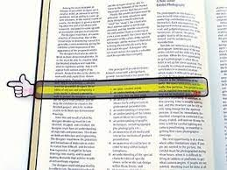
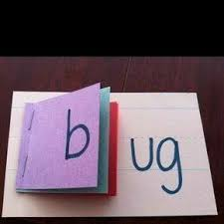
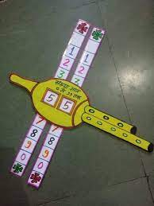
Assistive Devices for SLD

Slide 32
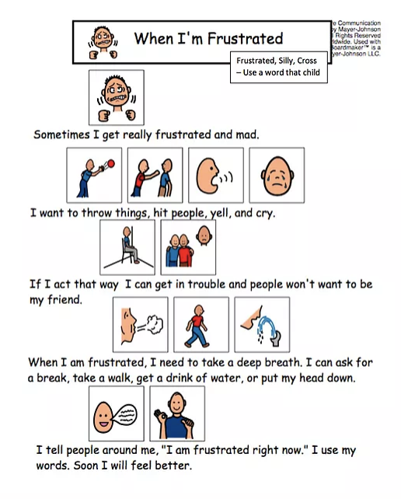
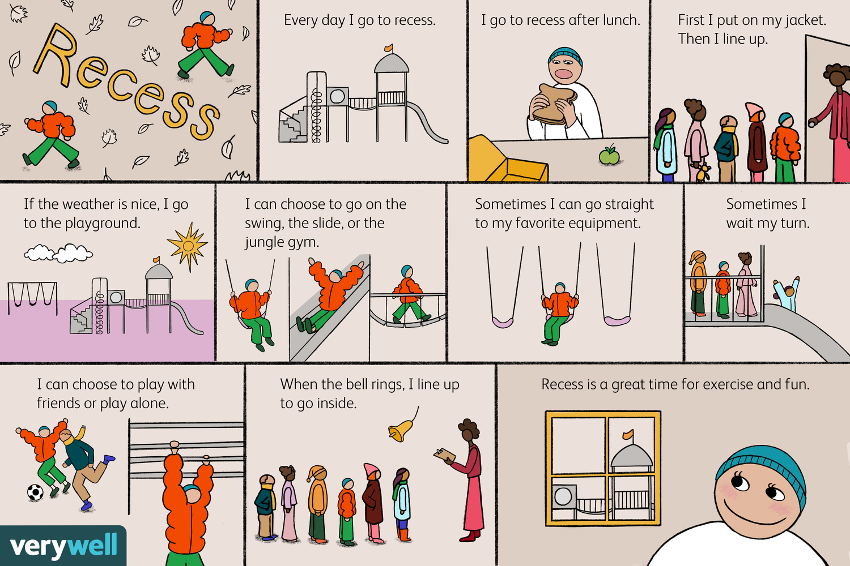
Assistive Devices for Autism Spectrum Disorder

Slide 33
.

Slide 35
.
Prof. Renu Malaviya
Dept. of Education
Lady Irwin College
University of Delhi

